Slide 2
Network Designs

Slide 3
Exploring Network Technologies and Tools
Given a scenario, implement secure network architecture concepts (3.2)
Install and configure network components to support organizational security (2.1)
3

Slide 4
Given a scenario, implement secure network architecture concepts
Secure Network Design
Network Access Control (NAC)
Zones and Topologies
Network Segmentation

Slide 5
Secure Network Designs
What problems arise from weaknesses in the network design/architecture?
Single points of failure
Complex dependencies
Availability over confidentiality and integrity
Lack of documentation and change control
Overdependence on perimeter security

Slide 6
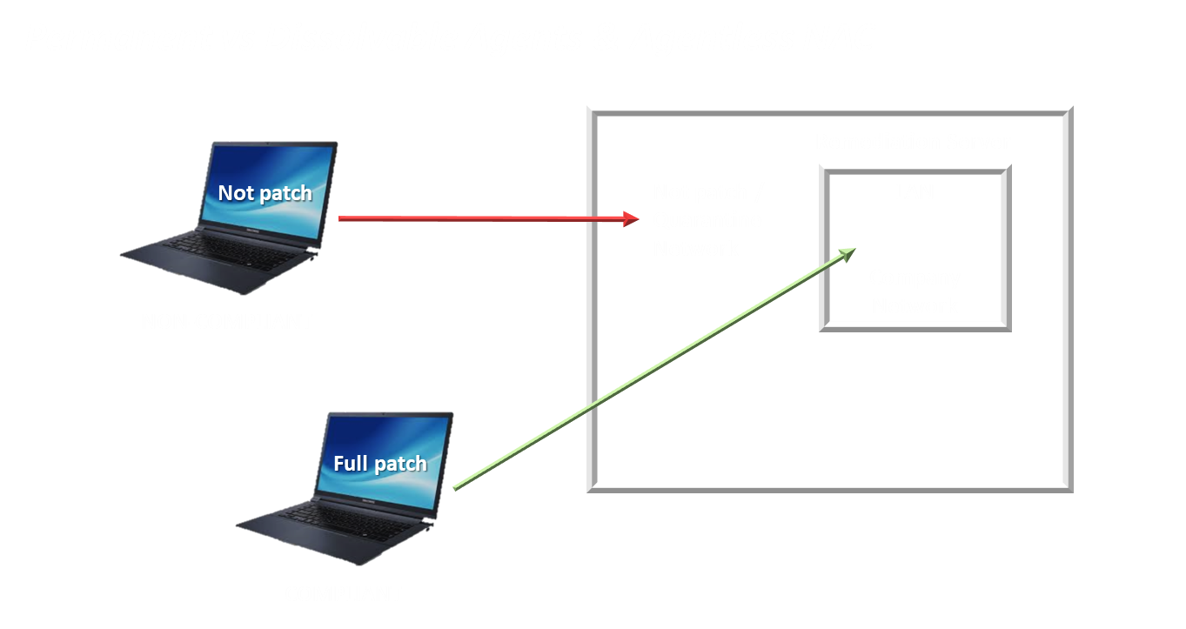
Network Access Control (NAC)
Performs host health checks before granting access
Normally performed by switches, rather than firewalls
“Comply to Connect”
Checks up-to-date antivirus software, patches, and security settings
Can redirect “unhealthy” clients to a remediation network
NAC systems use authentication agents (sometimes called health agents) to inspect NAC clients

Slide 7
Network Access Control (NAC)
Permanent vs Dissolvable Agents & Agentless NAC
Permanent
Installed on client and remains on client
Persistent NAC agent
Dissolvable
Downloaded to client when session starts, removed during or after session
Commonly used for mobile devices
Agentless
Checks client health using network/vulnerability scanning techniques
Most resource intensive
7

Slide 8








Given a scenario, implement secure network architecture concepts
IPS / IDS
DMZ
Router
Firewall
Web Server
Email Server
VPN Server
Database Server
Switch
Router
Switch
Switch
Internal Clients
Extranet Servers
Internal Servers

Slide 9
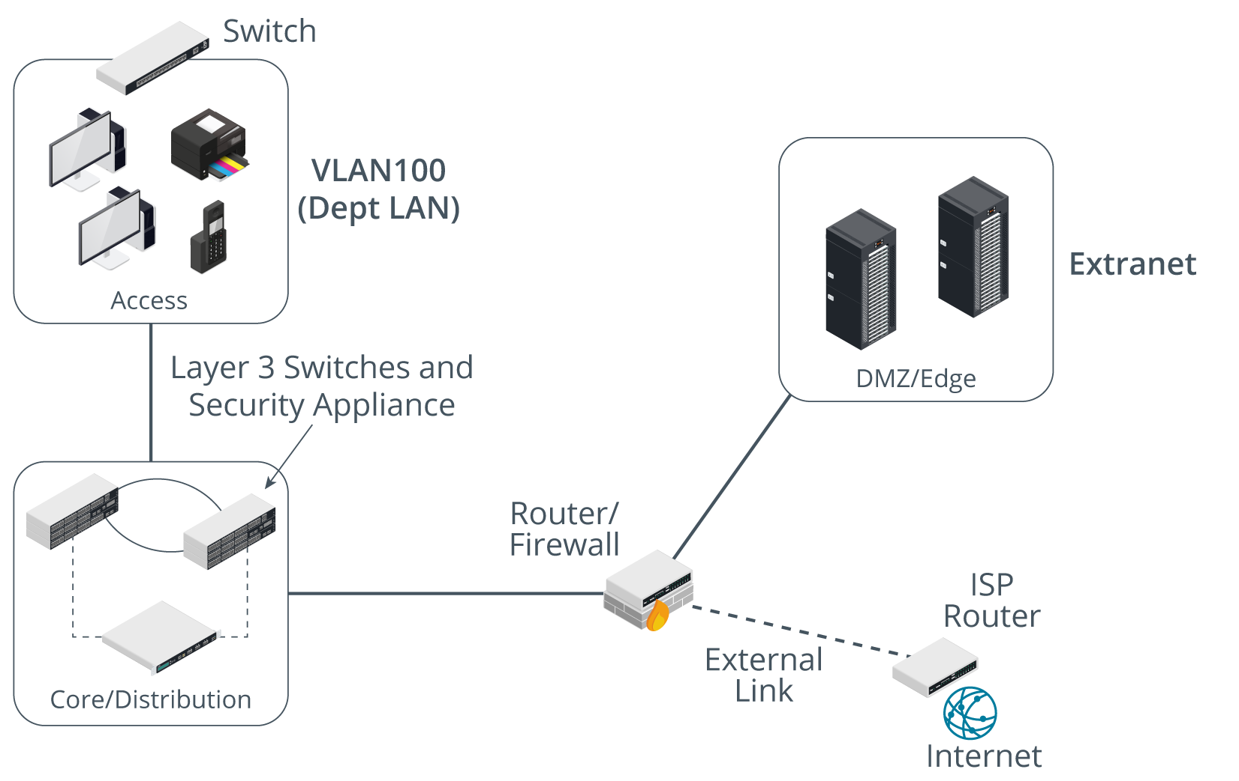
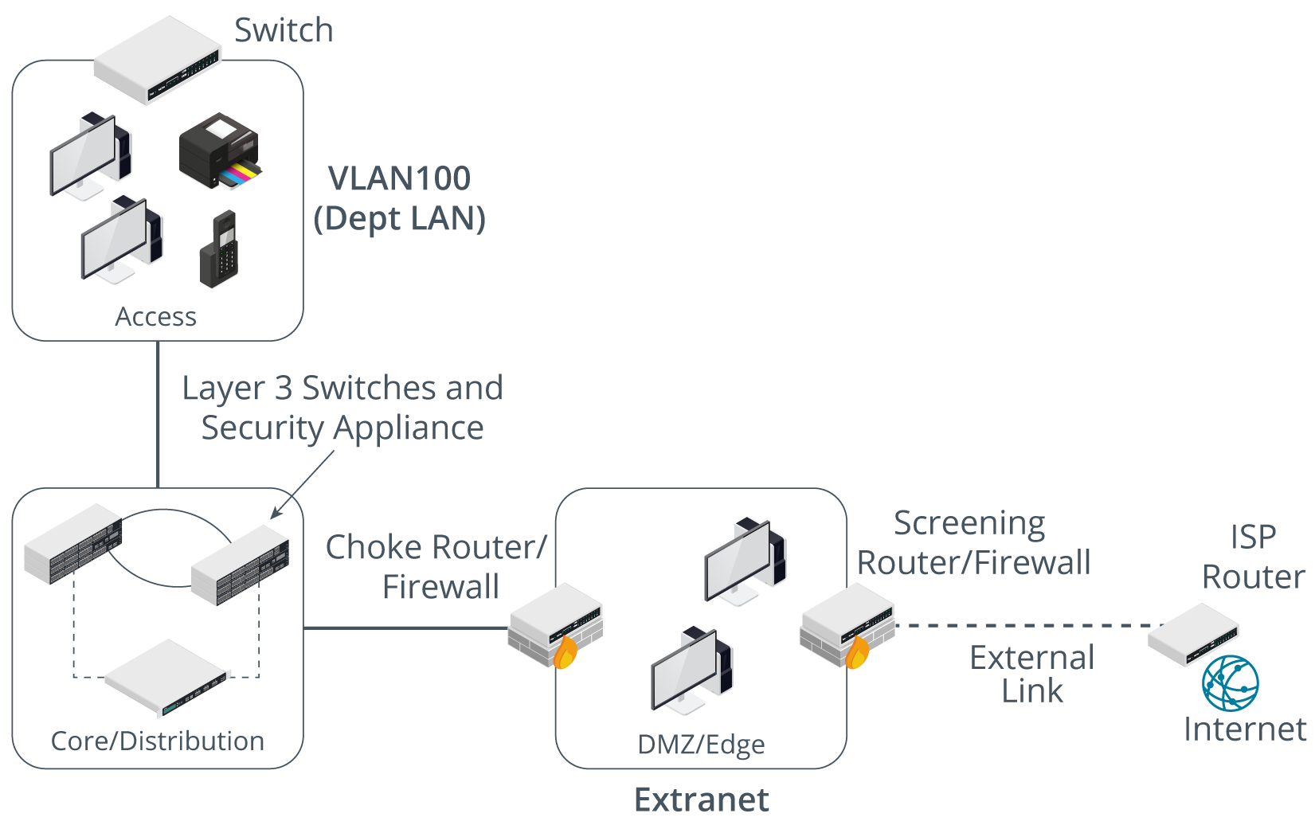
Demilitarized Zone Topologies
Triple-Homed Firewall
Screened Subnet

Slide 10
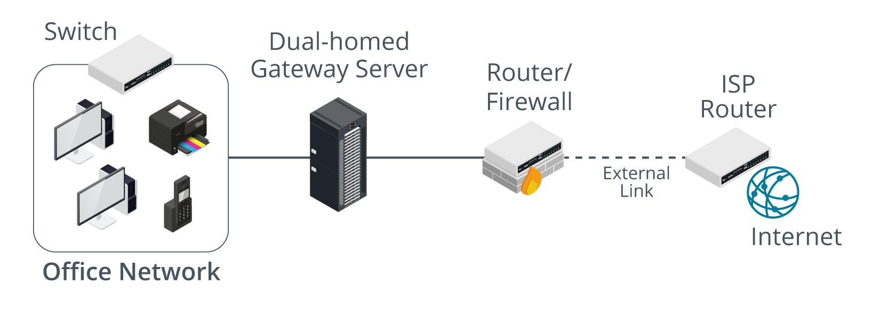
Demilitarized Zone Topologies
Screened Host
Notes:
For example, see this Netgear technical note: (kb.netgear.com/1118/How-do-I-configure-a-device-to-be-in-the-DMZ-on-my-NETGEAR-router). Be aware of this (mis)use of the term for the certification exam.

Slide 11

Network Address Translation (NAT)
11
Notes:
https://www.youtube.com/watch?v=FTUV0t6JaDA

Slide 12

Given a scenario, implement secure network architecture concepts
Network Address Translation (NAT)
Firewall must support NAT so that it can convert between public and private addresses, or this network will not function properly
A NAT hides the internal network from external resources and will separate host on a network
Internal Network
192.168.1.0/24
Internet
12.8.1.5/32
Firewall
Internal Network
192.168.1.0/24
Internet
12.8.1.5/32
Firewall

Slide 13







Given a scenario, implement secure network designs
Network Segmentation
East-west traffic
Traffic flows within a data center
Important to know where traffic starts and ends
East-west
Traffic between devices in the same data center
Relatively fast response times
North-south traffic
Ingress/egress to an outside device
A different security posture than east-west traffic
North-South Traffic
East-West Traffic

Slide 14




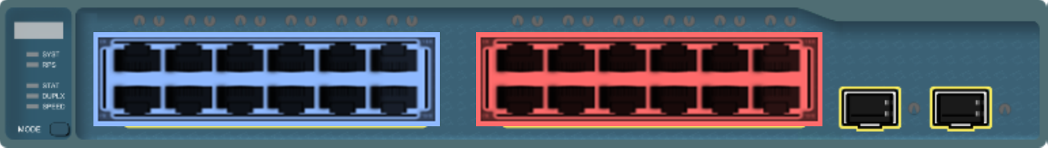


Given a scenario, implement secure network designs
Network segmentation
Physical Segmentation (air gap)
Separate Devices
Devices should be as isolated as possible
Secure network architecture concept that best protect the other servers if the legacy host were to be exploited
VOIP services
Computers
Printer Services
Legacy Devices

Slide 15
Given a scenario, implement secure network designs
Network segmentation
Virtual Local Area Network (VLAN)
Logically separates instead of physically
Devices should be able to communicate between VLANs without Layer 3 device (Router)
Use to separate Voice and data networks Example: (VOIP from Printers)
VOIP services
Computers
Printer Services

Slide 16
Install and configure network components to support organizational security
Proxy Servers
Firewalls
VPN
Unified Threat Management (UTM)
Notes:
I show Mike Meyers video on Proxy Servers on Udemy here.

Slide 17
Install and configure network components to support organizational security
Mike Myers- Proxy Servers
Notes:
I show Mike Meyers video on Proxy Servers on Udemy here.

Slide 18
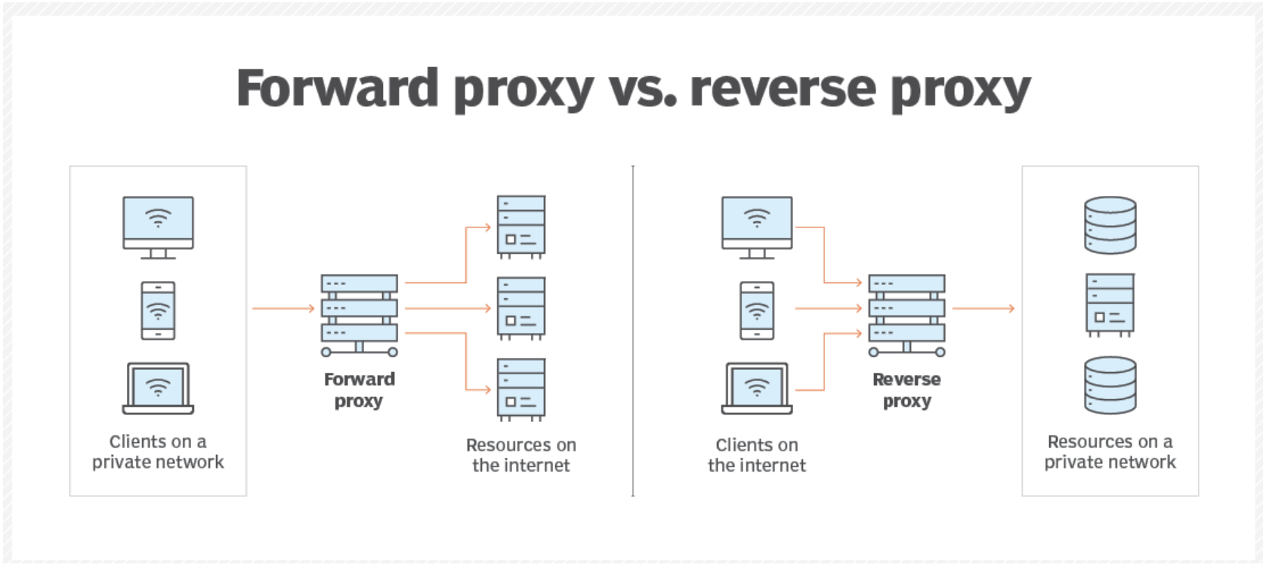
Proxy Servers
Forward proxies hide the client, and reverse proxies hide the server!
Notes:
https://www.theserverside.com/feature/Forward-proxy-vs-reverse-proxy-Whats-the-difference#:~:text=The%20key%20difference%20between%20a,to%20access%20a%20private%20subnet

Slide 19
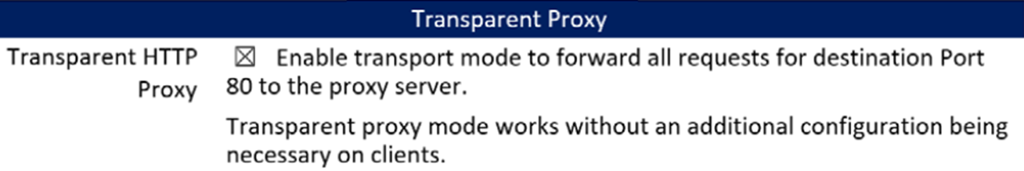
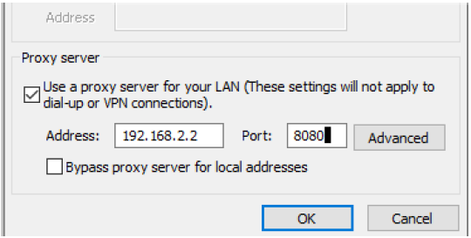
Given a scenario, implement secure network designs
Network Appliances
Transparent proxy
intercepts the request by the host to use HTTP TCP port 80 and forwards it to the proxy without modifying the requested web page
Non-transparent proxy
Intercepts and verifies the request is valid
Looks at the URL filter to see whether the site is blocked
Used to stop people caching webpages that are restricted

Slide 20
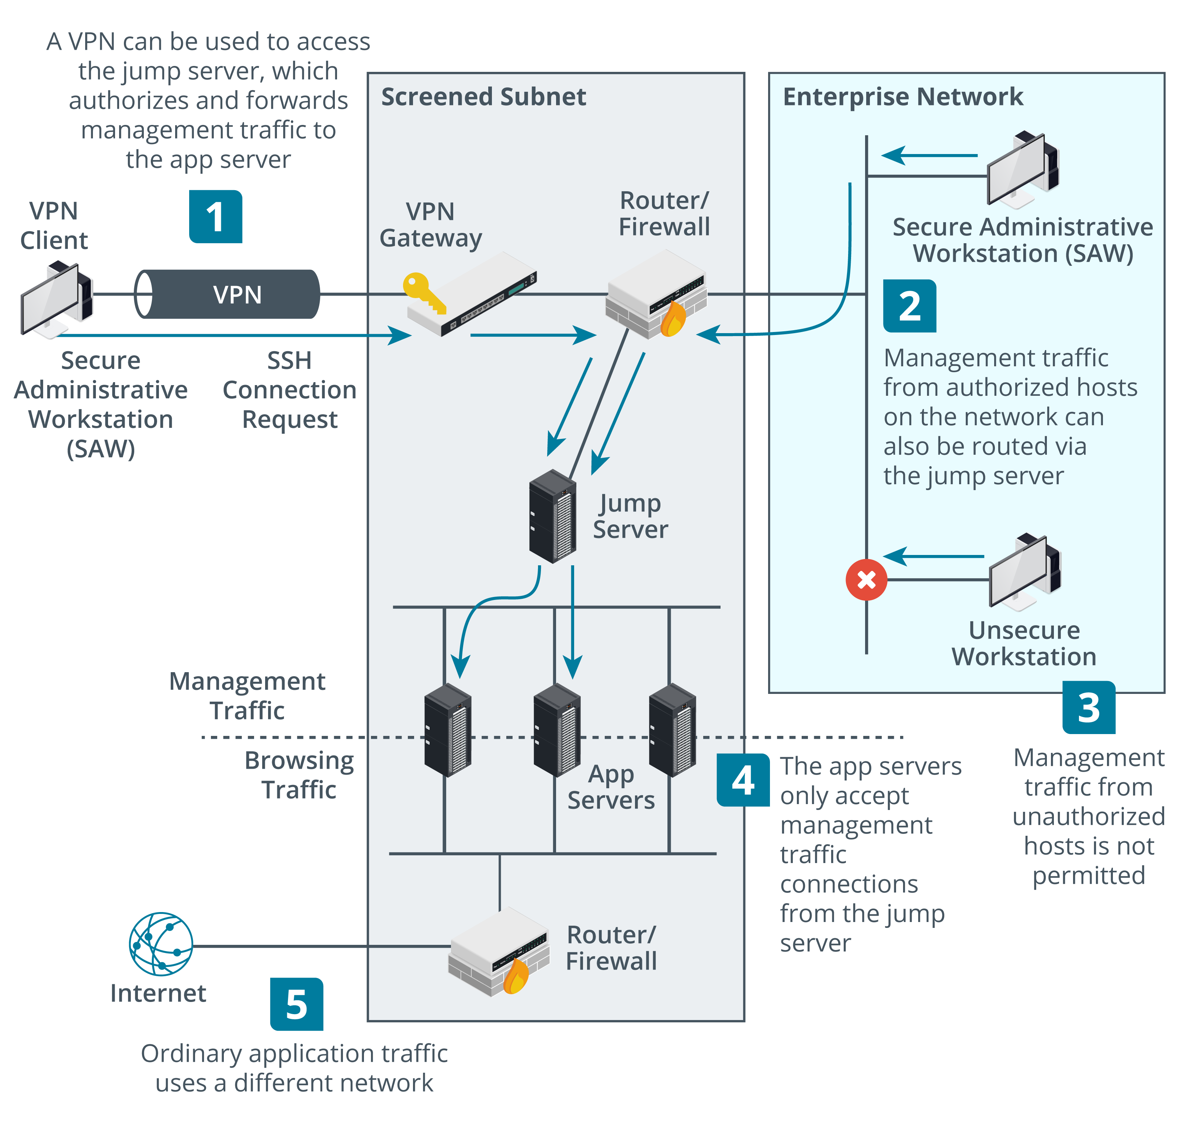
Out-of-band Management and Jump Servers
Secure admin workstations (SAWs)
Jump servers
Single host accepts SSH or RDP connections from SAWs
Forwards connections to app servers
App servers only accept connections from jump server
Notes:
Secure admin workstations (SAWs)
The secure admin workstations (SAWs) used to perform management functions must be tightly locked down, ideally installed with no software other than that required to access the administrative channel—minimal web browser, remote desktop client, or SSH virtual terminal, for instance. SAWs should be denied Internet access or be restricted to a handful of approved vendor sites (for patches, drivers, and support). The devices must also be subject to stringent access control and auditing so that any misuse is detected at the earliest opportunity.
Out-of-Band Management
Remote management methods can be described as either in-band or out-of-band (OOB). An in-band management link is one that shares traffic with other communications on the "production" network.
A serial console or modem port on a router is a physically out-of-band management method. When using a browser-based management interface or a virtual terminal over Ethernet and IP, the link can be made out-of-band by connecting the port used for management access to physically separate network infrastructure. This can be costly to implement, but out-of-band management is more secure and means that access to the device is preserved when there are problems affecting the production network.
Jump Servers
One of the challenges of managing hosts that are exposed to the Internet, such as servers and appliances in a DMZ, is to provide administrative access to them. Accessing these individual hosts directly from a secure zone may open their administrative interfaces to exploitation and be used as a pivot point back into the internal network. Consequently, the administrative servers in the secure zone that are permitted to access hosts in the DMZ must be tightly controlled. Configuring and auditing this type of control when there are many different servers operating in both zones is complex.
One solution to this complexity is to add a single administration server, or jump server, to the secure zone. The jump server only runs the necessary administrative port and protocol (typically SSH or RDP). Administrators connect to the jump server then use the jump server to connect to the admin interface on the application server. The application server's admin interface has a single entry in its ACL (the jump server) and denies connection attempts from any other hosts.

Slide 21
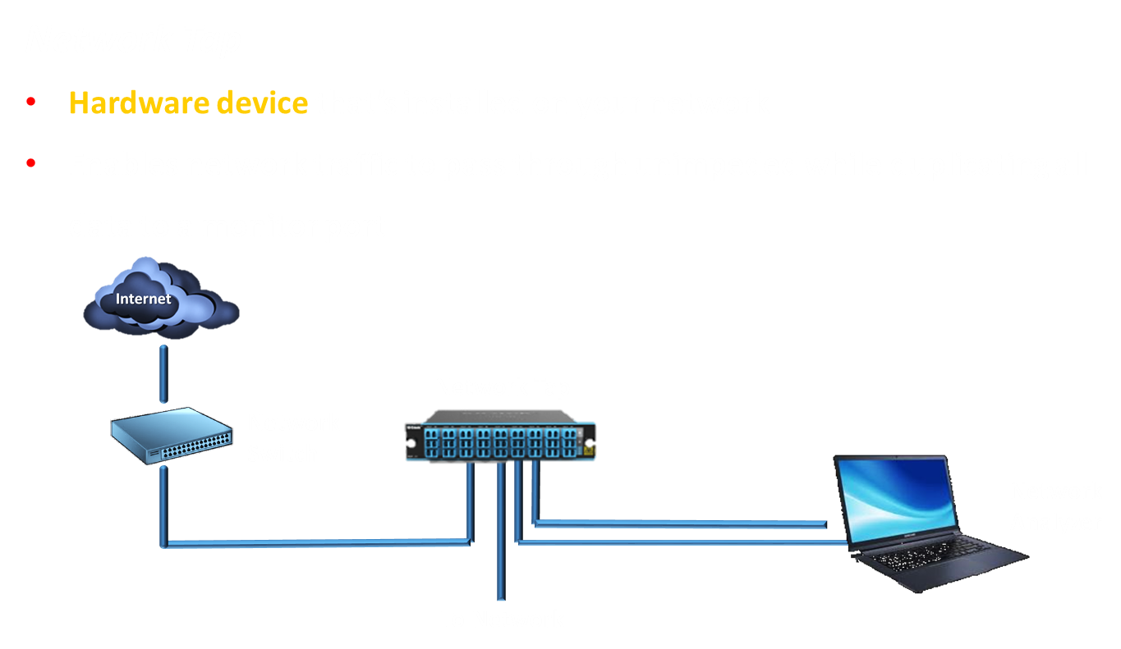
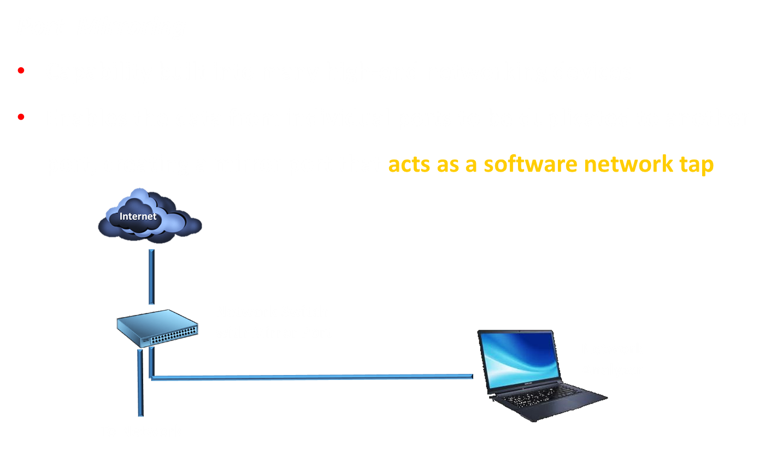
Network Tap & Port Mirroring
Monitor network traffic for vulnerabilities through the technique of port scanning
Both are passive monitoring
21
Notes:
TAPs and Port Mirrors
Typically, the packet capture sensor is placed inside a firewall or close to a server of particular importance. The idea is usually to identify malicious traffic that has managed to get past the firewall. A single IDS can generate a very large amount of logging and alerting data so you cannot just put multiple sensors everywhere in the network without provisioning the resources to manage them properly. Depending on network size and resources, one or just a few sensors will be deployed to monitor key assets or network paths.
There are three main options for connecting a sensor to the appropriate point in the network:
• SPAN (switched port analyzer)/mirror port—this means that the sensor is attached to a specially configured port on the switch that receives copies of frames addressed to nominated access ports (or all the other ports). This method is not completely reliable. Frames with errors will not be mirrored and frames may be dropped under heavy load.
• Passive test access point (TAP)—this is a box with ports for incoming and outgoing network cabling and an inductor or optical splitter that physically copies the signal from the cabling to a monitor port. There are types for copper and fiber optic cabling. Unlike a SPAN, no logic decisions are made so the monitor port receives every frame—corrupt or malformed or not—and the copying is unaffected by load.
• Active TAP—this is a powered device that performs signal regeneration (again, there are copper and fiber variants), which may be necessary in some circumstances. Gigabit signaling over copper wire is too complex for a passive tap to monitor and some types of fiber links may be adversely affected by optical splitting. Because it performs an active function, the TAP becomes a point of failure for the links in the event of power loss. When deploying an active TAP, it is important to use a model with internal batteries or connect it to a UPS.
A TAP will usually output two streams to monitor a full-duplex link (one channel for upstream and one for downstream). Alternatively, there are aggregation TAPs, which rebuild the streams into a single channel, but these can drop frames under very heavy load.

Slide 22
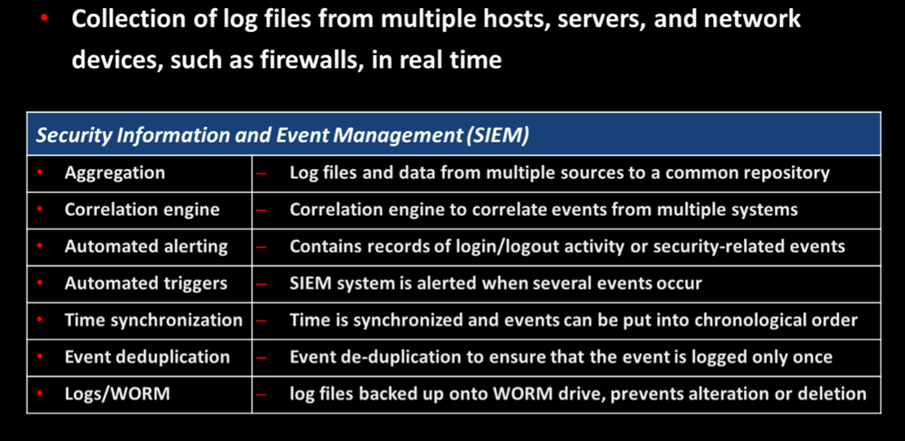
SIEM
Notes:
SIEM https://www.solarwinds.com/security-event-manager/use-cases/siem-monitoring-tool

Slide 23
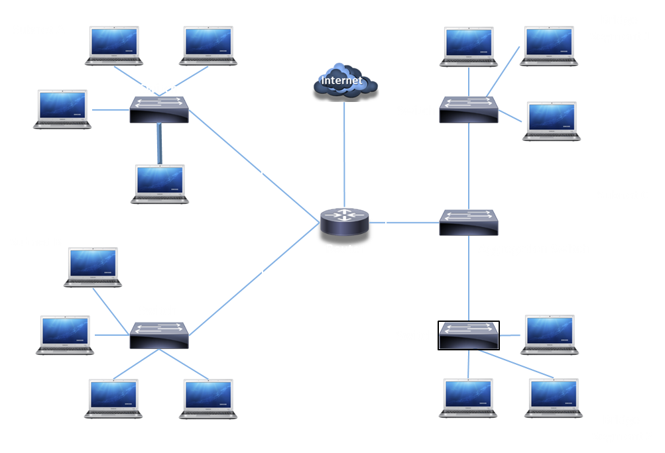
Given a scenario, implement secure protocols
Routing & Switching
Aggregation Switch
Connects multiple switches together

Slide 24
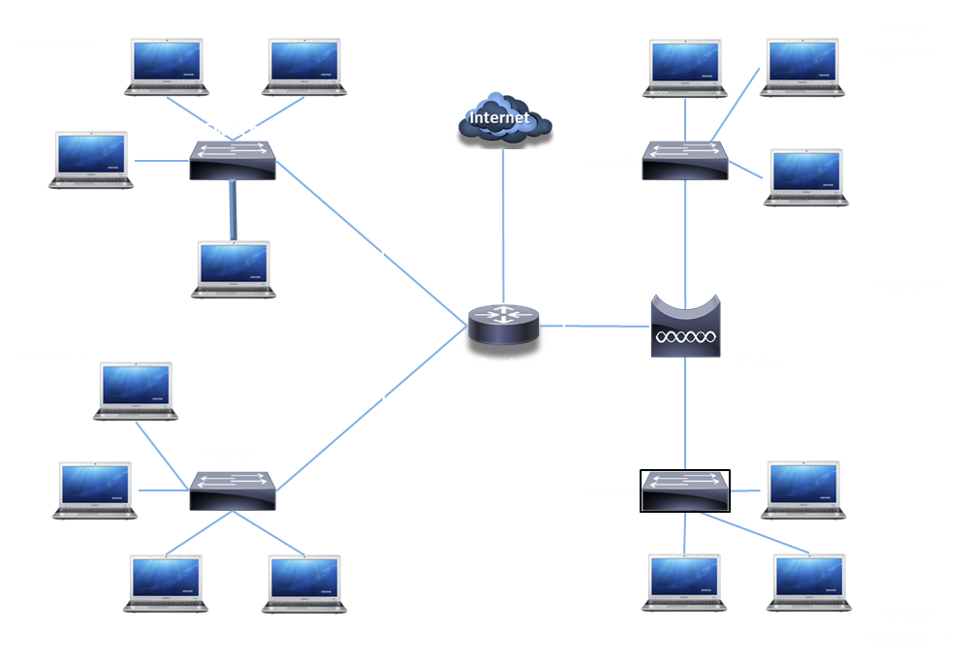
Given a scenario, implement secure protocols
Routing & Switching
Bridge
Connects networks
Can be used instead of a router

Slide 25
Install and configure network components to support organizational security
Firewalls & Router ACLs
Prevents unauthorized access and that access to data is logged
Filters incoming and outgoing traffic for a single host or between networks
Admins configure an Access Control List (ACL) to allow/deny traffic
PERMIT TCP from: ANY to: 192.168.1.10:80 PERMIT TCP from: ANY to: 192.168.1.10:443 DENY TCP from: ANY to: ANY
“Implicit Deny” is set at the bottom of an ACL
Denies anything not explicitly allowed through
Notes:
barracuda.com, checkpoint.com, fortinet.com, or pfsense.org

Slide 26

Install and configure network components to support organizational security
Stateful
Makes decisions based on context, or state, of traffic
Inspects Ethernet traffic at most levels of the OSI model
Can prevent DoS and DDoS attacks
Can ensure TCP traffic is part of an established TCP session
If not, traffic is blocked
Stateless
A stateless firewall controls traffic between networks using rules within an ACL
Packets are viewed in isolation instead of comparing to a record
Ends with deny any (or something similar)

Slide 27
Firewalls
Apr 6 17:57:29 edda kernel: [375785.492469) [UFW BLOCK) IN=ens160 OUT= MAC=00:00:00:0d0::f2f:000:c:29:c5:0:000:00:S0R0C=4.4.4.12OST=4.4.4.1 LEN=66 TOS=0x00 PREC=0x00TTL=64I0=409B3 OF PROTO=UOP SPT=51096OPT=53 LEN=46
Apr 6 17:57:33 edda kernel: (37578.94937)62(UFW BLOCK] IN=ensl60 OUT= MAC=00:00:00:0d:0f:f2:000:c:2:9c5:00:00:00:S0R0C=4.4.4.12DST=4.4.4.l LEN=66 TOS=0x00 PREC=0x00 TTL=64 I0=47151 OF PROTO=UDP SPT=51096 OPT=S3 LEN=46
Apr 6 17:57:42 edda kernel:(375798.496433) (UFW BLOCK) lN=esn160OUT= MAC=00:00:00:00:2d:ffc::2090::0c5:00:00:0S0R:C0=40,4.41,2OST=4.4.4,1 LEN=44TOS=0x00 PREC=0x00 TTL=37 I0=37826PROTO=TCP SPT=50062DPT=143 WINDOW:1024 RES=0x00 SYN URGP=0
Apr 6 17:57:42 edda kernel: (375798.496448) [UFW BLOCK) 1N=ens160OUT= MAC=00:00:00:00:2d:ffc::2090::c05:00:00:0S0R:C=040.4.4.12 DST=4,4.4.LlEN=44 TOS=0x00 PREC=0x00 TTL=37I0=41141 PROTO=TCP SP:T 50062DPT=199 WINDOW:1024 RES=0x00 SYN URGP=0
Apr 6 17:57:42 edda kernel:(375798.496457) [UFW BLOCK) IN=ens160 OUT= MAC=00:00:00:0d0::f2f:000:c:29:c5:0:000:00:0SR0C=4,4,4,12DST=4,4.41, LEN=44 TOS=0x00 PREC=0x00TTL=4B I0=24746PROTO=TCP SPT=50062DPT=lllWINDOW:1024 RES=0x00SYN URGP=0
Unix - Linux Firewall (UFW)
Uses IP tables to inspect and properly handle network-based traffic

Slide 28
Install and configure network components to support organizational security
Web Application Firewall (WAF)
Specialized firewall used to prevent attacks on web servers and the applications that they host
Blocks attacks and provides security at layer 7 of the OSI model
Monitors communications to and from a web server
Method to implement High Availability (HA) in a web application server environment
Network Appliances
Web Application Firewall (WAF)
WAF Audit mode
Logs are created but requests and responses are not blocked
Used to analyze the logs and adjust the rules and settings as needed before enabling Block Mode
Generates alerts or alerts can be created
WAF Block mode
Used to block HTTP/HTTPS traffic when rules meet specific parameters
Blocks Request
Blocks Post

Slide 29
3.2 Given a scenario, implement host or application security solutions
Endpoint protection
Next-Generation Firewall (NGFW)
Act as a stateful firewall by carrying out deep packet filtering
Inspect application traffic to ensure that it is legitimate
Use whitelisting to ensure only approved applications can run
Inspect encrypted SSL and HTTPS packets

Slide 30

Install and configure network components to support organizational security
Mail Gateway or Email Security Gateway
Is a device that sits in a DMZ to scan incoming and outgoing email for viruses
Commonly performs:
Spam filtering
Malware filtering
Data loss prevention
Encryption
30

Slide 31
Install and configure network components to support organizational security
Content Filter
Designed to apply several user-focused filtering
rules, such as blocking uniform resource locators (URLs) that appear on content blacklists or applying time-based restrictions to browsing.
Usually implemented as a class of product called a secure web gateway (SWG).
Also performs threat analysis ,
Implements data loss prevention (DLP)
Implements cloud access security brokers (CASB) to protect against the full range of unauthorized egress threats, including malware command and control and data exfiltration.

Slide 32
Given a scenario, implement secure network designs
Network Appliances
Intrusion Detection System (NIDS) / Intrusion Prevention System (NIPS)
Watch network traffic intrusions exploits against:
Operating systems
Applications
Buffer overflows
Cross-site scripting
Other vulnerabilities
Detection vs. Prevention
Detection – Alarm or alert
Prevention – Stop it before it gets into the network

Slide 33
Given a scenario, implement secure network designs
Network Appliances
Intrusion Detection System (NIDS) -Passive monitoring
Examine a copy of the traffic
Port mirror (SPAN), network tap
No way to block (prevent) traffic
Passive (out-of-band) response
Detective control- attempts to detect attacks after they occur
Detection engine performs real-time analysis of indicators
Intrusion Prevention System (NIPS)
When malicious traffic is identified
IPS sends TCP RST (reset) frames
Limited UDP response available
In-band response

Slide 34




Given a scenario, implement secure network designs
Network Appliances
Attacker
Active IPS Deployment
Firewall
Router
IPS
Switch
Attacker
Passive IDS Deployment
Switch
Firewall
Router
IDS

Slide 35
Given a scenario, implement secure network designs
Network Appliances
Identification technologies
Signature-based
Look for a perfect pattern match
Detects possible intrusions based upon a vendor provided list (Database of known attack signatures)
Anomaly-based
Build a baseline of what’s “normal”
Can detect a spike in network traffic as a result of threat
Behavior-based
Observe and report
Protects against zero day attacks and unrecognized threats
Heuristics
Use artificial intelligence to identify
Protective measures to stop a virus evading detection
Must be updated with latest definitions /plug-ins/feeds
Many attack tools do not conform to specific signatures

Slide 36
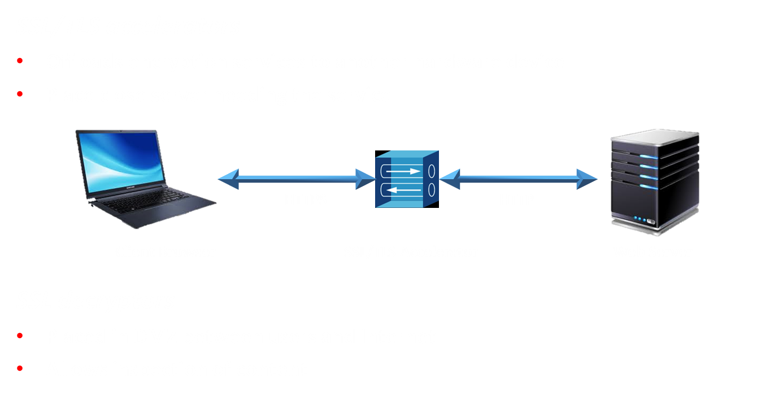
Intrusion Detection And Prevention Systems
36

Slide 37
Given a scenario, implement secure protocols
Network address allocation
The broadcast ID is used to send traffic to all hosts
Cannot use an IP address that ends in a zero or 255
172.16.35.255 = Broadcast IP address
127 is technically a Class A address
127.0.0.1 = Loopback IP address
Cannot allocate it to a host as it is used for diagnostic testing
CIDR Mask
4 octets each of 8 bits, making it 32-bit IP addressing
CIDR mask of /24, that means I then have 24 bits for the network and 8 bits for hosts:
/8 is the same as 255.0.0.0, as it uses 8 bits from the left
/16 is the same as 255.255.0.0, as it uses 16 bits from the left
/24 is the same as 255.255.255.0, as it uses 24 bits from the left

Slide 38
3.1 Given a scenario, implement secure protocols
Routing
Routers
Device that connects two different networks together
When setting up a host machine; it is known as the default gateway
Send IP packets across the network
Forwarding decisions are based on destination IP address
Each router only knows the next step
The packet asks for directions every hop along the way
The list of directions is held in a routing table

Slide 39
3.1 Given a scenario, implement secure protocols
Routing
The routing table
Every IP device has a list of routes
Workstation
Routers
Servers
ect.
Destination IP has to match a routing table entry if not, it’s dropped
Adding a static default route can simplify your routing table
If it doesn’t match an entry, use this route

Slide 40
3.1 Given a scenario, implement secure protocols
Routing & Switching
The switch with the lowest MAC address is the root
Forward or drop frames based on the destination MAC address
Gather a constantly updating list of MAC addresses
Builds the list based on the source MAC address of incoming traffic
Also known as MAC address table
Maintain a loop-free environment using
Spanning Tree Protocol (STP) or Rapid Spanning Tree Protocol (RSTP)
BPDU attack will try and spoof the root bridge so that the STP is recalculated
BPDU Guard enables the STP to stop such attempts
Port security
Prevent unauthorized users from connecting to unused ports
Provide increased segmentation of user computers
VLANs

Slide 41
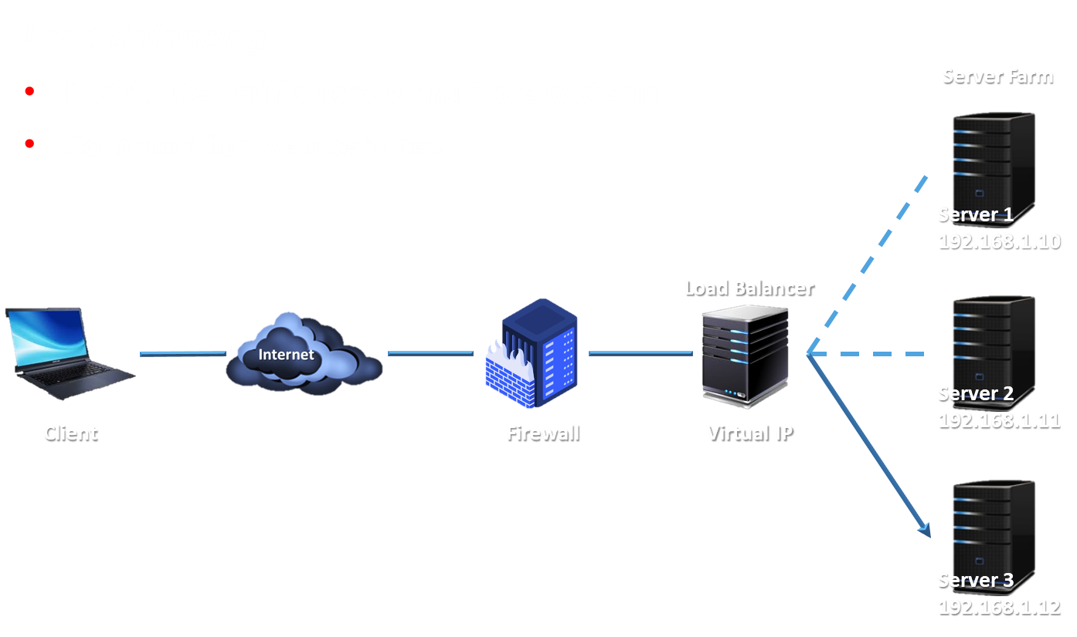
Load Balancing
41
41
Notes:
There are two main types of load balancers:
Layer 4 load balancer—basic load balancers make forwarding decisions on IP address and TCP/UDP port values, working at the transport layer of the OSI model.
Layer 7 load balancer (content switch)—as web applications have become more complex, modern load balancers need to be able to make forwarding decisions based on application-level data, such as a request for a particular URL or data types like video or audio streaming. This requires more complex logic, but the processing power of modern appliances is sufficient to deal with this.
Scheduling
The scheduling algorithm is the code and metrics that determine which node is selected for processing each incoming request. The simplest type of scheduling is called round robin; this just means picking the next node. Other methods include picking the node with the fewest connections or the best response time. Each method can also be weighted, using administrator set preferences or dynamic load information or both.
The load balancer must also use some type of heartbeat or health check probe to verify whether each node is available and under load or not. Layer 4 load balancers can only make basic connectivity tests while layer 7 appliances can test the application's state, as opposed to only verifying host availability.
﻿
Source IP Affinity and Session Persistence
When a client device has established a session with a particular node in the server farm, it may be necessary to continue to use that connection for the duration of the session. Source IP or session affinity is a layer 4 approach to handling user sessions. It means that when a client establishes a session, it becomes stuck to the node that first accepted the request.
An application-layer load balancer can use persistence to keep a client connected to a session. Persistence typically works by setting a cookie, either on the node or injected by the load balancer. This can be more reliable than source IP affinity, but requires the browser to accept the cookie.
Spanning Tree Protocol, and its improved versions, are required mainly for two reasons – To prevent network loops (due to multiple paths to the same destination) & to introduce redundancy in the link connections (if one link fails, the data is still routed through a different link/route).
Network loops sometimes happen inadvertently, especially in large networks. When there are two or more paths to the same destination, there is a danger of broadcast packets getting in to an infinite loop and hence causing congestion in the network. So, STP is used to identify the best path to the destination, and block all other paths (links). The blocked links are not always discarded. They are connected and kept inactive by STP, so that, when the best path fails – the next best path can be achieved by activating the blocked links.
• The main difference between Rapid Spanning Tree Protocol (RSTP IEEE 802.1W) and Spanning Tree Protocol (STP IEEE 802.1D) is that Rapid Spanning Tree Protocol (RSTP IEEE 802.1W) assumes the three Spanning Tree Protocol (STP) ports states Listening, Blocking, and Disabled are same (these states do not forward Ethernet frames and they do not learn MAC addresses).
See Understanding Spanning Tree Protocols – STP, RSTP, MSTP- https://excitingip.com/1688/understanding-spanning-tree-protocols-stp-rstp-mstp/
A bridge protocol data unit (BPDU) is a data message transmitted across a local area network to detect loops in network topologies. A BPDU contains information regarding ports, switches, port priority and addresses. BPDUs contain the information necessary to configure and maintain spanning tree topology.
For BPDU attacks see https://www.ciscozine.com/how-to-protect-against-bpdu-attack/

Slide 42
Load Balancing
Round Robin
The load balancer sends the first request to server 1, the second request to server 2, and so on
Weighted Round Robin
Prioritizes server use based on the capabilities of the servers
Dynamic Round Robin
Monitors the server load and distributes to the server with the lowest use
Affinity
Sends requests to the same server based on the requestor’s IP address
42
42

Slide 43
3.3 Given a scenario, implement secure network designs
NIC teaming
Load Balancing / Fail Over (LBFO)
Technique of grouping physical network adapters to improve performance and redundancy
Aggregate (grouping)
Bandwidth
Redundant paths
Multiple network adapters looks like a single adapter
Integrate with switches
NICs talk to each other
Fails over when a NIC doesn’t respond
Should one adapter fail, the other adapter can be used for load balancing

Slide 44
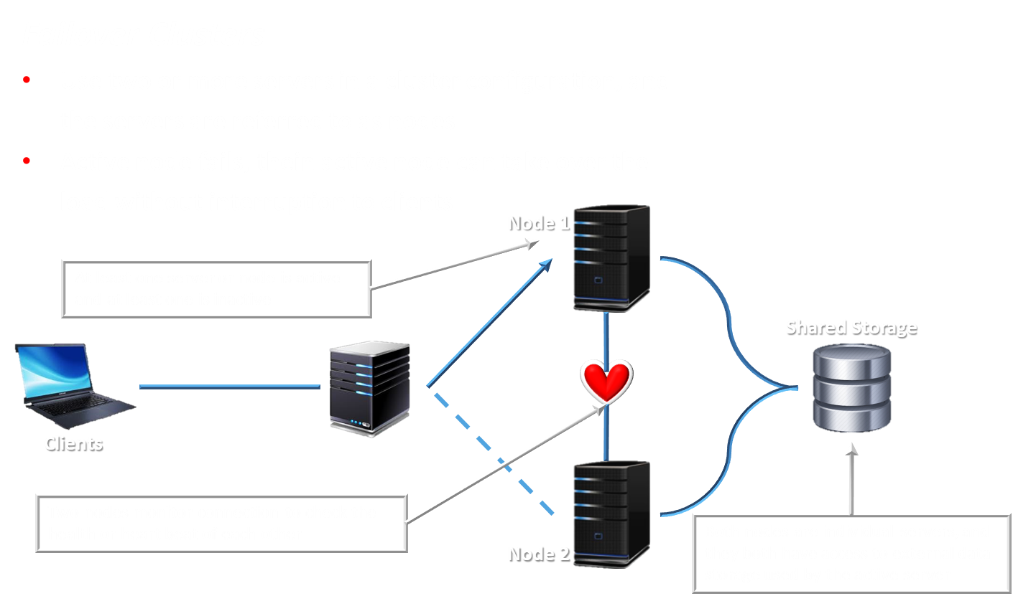
Failover Clusters
44
44
Notes:
Active/Passive (A/P) and Active/Active (A/A) Clustering
In this example, if one node is active, the other is passive. This is referred to as active/passive clustering. The major advantage of active/passive configurations is that performance is not adversely affected during failover. However, the hardware and operating system costs are higher because of the unused capacity.
An active/active cluster means that both nodes are processing connections concurrently. This allows the administrator to use the maximum capacity from the available hardware while all nodes are functional. In the event of a failover the workload of the failed node is immediately and transparently shifted onto the remaining node. At this time, the workload on the remaining nodes is higher and performance is degraded.
Application Clustering
Provides stateful fault tolerance
Where a load balancer distributes client requests between available nodes, clustering enables load balancing "within" a group of servers.
Clustering is also very commonly used to provision fault tolerant application services. If an application server suffers a fault in the middle of a session, the session state data will be lost. Application clustering allows servers in the cluster to communicate session information to one another. For example, if a user logs in on one instance, the next session can start on another instance, and the new server can access the cookies or other information used to establish the login.

Slide 45

VPN
Notes:
https://www.youtube.com/watch?v=EGwFEQkyLlM

Slide 46
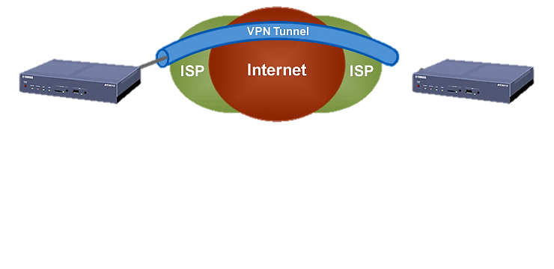
Given a scenario, implement secure network designs
Virtual private network (VPN)
IPsec (Internet protocol Security)
IPSec can be used to create a secure session between
two hosts on a network and it has two different modes:
Tunnel Mode:
Both the header and the payload are encrypted
It's normally used externally
Used with L2TP/IPSec VPNs,
Transport Mode
This is used between two servers or hosts on an internal network
Only the payload is encrypted

Slide 47

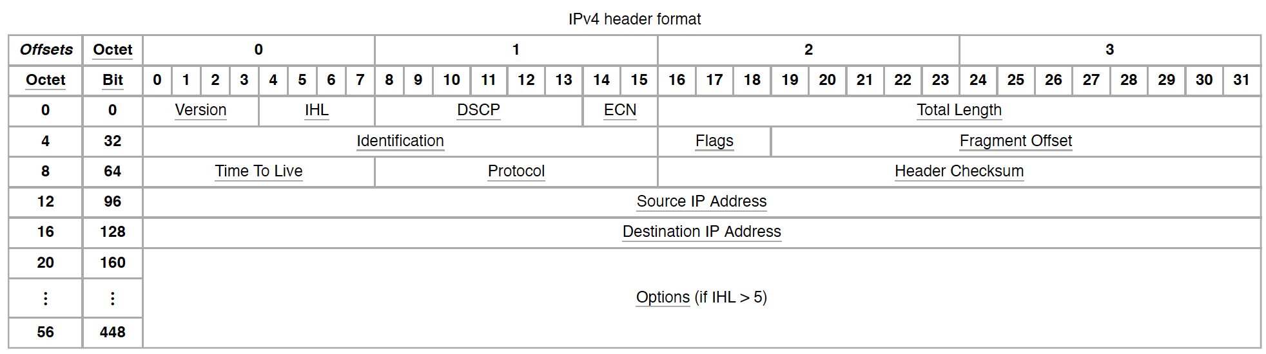
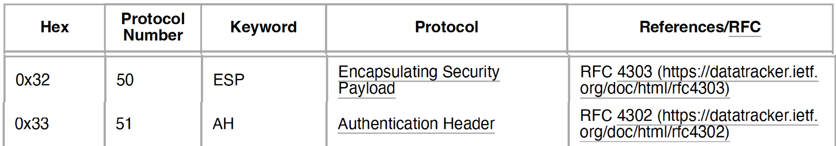
Given a scenario, implement secure network designs
Virtual private network (VPN)
IPsec (Internet protocol Security)
Authentication Header (AH) – IP Protocol #51
Ensures that the packet header has not been tampered with in transit
Encapsulating Security Payload (ESP) – IP Protocol #50
Symmetric encryptions using block ciphers
Notes:
Version
The first header field in an IP packet is the four-bit version field. For IPv4, this is always equal to 4.
Internet Header Length (IHL)
The IPv4 header is variable in size due to the optional 14th field (options). The IHL field contains the size of the IPv4 header; it has 4 bits that
specify the number of 32-bit words in the header. The minimum value for this field is 5,[37] which indicates a length of 5 Å~ 32 bits = 160 bits = 20
bytes. As a 4-bit field, the maximum value is 15; this means that the maximum size of the IPv4 header is 15 Å~ 32 bits = 480 bits = 60 bytes.
Differentiated Services Code Point (DSCP)
Originally defined as the type of service (ToS), this field specifies differentiated services (DiffServ) per RFC 2474.[a] Real-time data streaming
makes use of the DSCP field. An example is Voice over IP (VoIP), which is used for interactive voice services.
Explicit Congestion Notification (ECN)
This field is defined in RFC 3168 and allows end-to-end notification of network congestion without dropping packets. ECN is an optional feature
available when both endpoints support it and effective when also supported by the underlying network.
Total Length
This 16-bit field defines the entire packet size in bytes, including header and data. The minimum size is 20 bytes (header without data) and the
maximum is 65,535 bytes. All hosts are required to be able to reassemble datagrams of size up to 576 bytes, but most modern hosts handle
much larger packets. Links may impose further restrictions on the packet size, in which case datagrams must be fragmented. Fragmentation in
IPv4 is performed in either the sending host or in routers. Reassembly is performed at the receiving host.
Identification
This field is an identification field and is primarily used for uniquely identifying the group of fragments of a single IP datagram. Some experimental
work has suggested using the ID field for other purposes, such as for adding packet-tracing information to help trace datagrams with spoofed
source addresses,[38] but RFC 6864 now prohibits any such use.
Flags
A three-bit field follows and is used to control or identify fragments. They are (in order, from most significant to least significant):
!"bit 0: Reserved; must be zero.[b]
!"bit 1: Don't Fragment (DF)
!"bit 2: More Fragments (MF)
If the DF flag is set, and fragmentation is required to route the packet, then the packet is dropped. This can be used when sending packets to a
host that does not have resources to perform reassembly of fragments. It can also be used for path MTU discovery, either automatically by the
host IP software, or manually using diagnostic tools such as ping or traceroute.
For unfragmented packets, the MF flag is cleared. For fragmented packets, all fragments except the last have the MF flag set. The last fragment
has a non-zero Fragment Offset field, differentiating it from an unfragmented packet.
Fragment offset
This field specifies the offset of a particular fragment relative to the beginning of the original unfragmented IP datagram in units of eight-byte
blocks. The first fragment has an offset of zero. The 13 bit field allows a maximum offset of (213 – 1) Å~ 8 = 65,528 bytes, which, with the header
length included (65,528 + 20 = 65,548 bytes), supports fragmentation of packets exceeding the maximum IP length of 65,535 bytes.
Time to live (TTL)
An eight-bit time to live field limits a datagram's lifetime to prevent network failure in the event of a routing loop. It is specified in seconds, but time
intervals less than 1 second are rounded up to 1. In practice, the field is used as a hop count—when the datagram arrives at a router, the router
decrements the TTL field by one. When the TTL field hits zero, the router discards the packet and typically sends an ICMP time exceeded
message to the sender.
The program traceroute sends messages with adjusted TTL values and uses these ICMP time exceeded messages to identify the routers
traversed by packets from the source to the destination.
Protocol
This field defines the protocol used in the data portion of the IP datagram. IANA maintains a list of IP protocol numbers as directed by RFC 790 (https://www.rfc-editor.org/rfc/rfc790).
Header checksum
The 16-bit IPv4 header checksum field is used for error-checking of the header. When a packet arrives at a router, the router calculates the
checksum of the header and compares it to the checksum field. If the values do not match, the router discards the packet. Errors in the data field
must be handled by the encapsulated protocol. Both UDP and TCP have separate checksums that apply to their data.
When a packet arrives at a router, the router decreases the TTL field in the header. Consequently, the router must calculate a new header
Checksum.
The checksum field is the 16 bit one's complement of the one's complement sum of all 16 bit words in the header. For purposes of computing the
checksum, the value of the checksum field is zero.
Source address
This field is the IPv4 address of the sender of the packet. Note that this address may be changed in transit by a network address translation
device.
Destination address
This field is the IPv4 address of the receiver of the packet. As with the source address, this may be changed in transit by a network address
translation device.
Options
The options field is not often used. Packets containing some options may be considered as dangerous by some routers and be blocked.[39] Note
that the value in the IHL field must include enough extra 32-bit words to hold all the options plus any padding needed to ensure that the header
contains an integer number of 32-bit words. If IHL is greater than 5 (i.e., it is from 6 to 15) it means that the options field is present and must be
considered. The list of options may be terminated with an EOOL (End of Options List, 0x00) option; this is only necessary if the end of the options
would not otherwise coincide with the end of the header.

Slide 48
Given a scenario, implement secure protocols
VPN Concentrator
Used for site-to-site & host-to-site VPN architectures
Establishes and configures tunnels
Authenticates users
Assign tunnel/IP addresses to users
Encrypt and decrypt data
Ensure end-to-end delivery of data
Could occur when both strong and weak ciphers are configured on a VPN concentrator
IPSec payload reverts to 16-bit sequence numbers instead of 32-bit (strong)
An attacker could potentially perform a downgrade attack (weak)
48

Slide 49



Given a scenario, implement secure network designs
Site-to-Site VPNs
Encrypt traffic between sites
Through the public Internet
Use existing Internet connection
No additional circuits or costs
VPN
Concentrator
VPN
Concentrator

Slide 50



Given a scenario, implement secure network designs
Host-to-Site VPNs (remote access VPN)
Requires software on the user device
May be built-in to existing operating system
Corporate Network
VPN Concentrator
Remote User

Slide 51
Given a scenario, implement secure network designs
Host-to-Host VPNs
User to user encryption
Software-based
No hardware needed
Remote User
Remote User
Remote User
Remote User

Slide 52

Given a scenario, implement secure network designs
Full tunnel
Encrypts all traffic from client
Can route client traffic through UTM in private network for
monitoring and protection
The process is reversed for the return traffic
Remote user creates a secure tunnel to the VPN concentrator
Corporate Network
VPN Concentrator
Remote User
VPN concentrator decrypts the tunneled traffic and routes it into the corporate network

Slide 53

Given a scenario, implement secure network designs
Split tunnel
Encrypts only some traffic (such as traffic going to private network)
Traffic to all other sites is “split” from the tunnel and is not encrypted
Corporate Network
VPN Concentrator
Remote User
Remote user creates a secure tunnel to the VPN concentrator

Slide 54
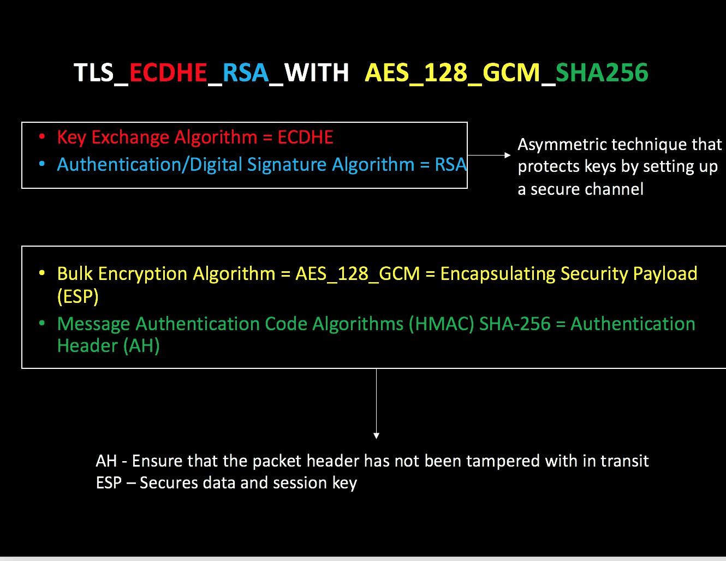
VPN Algorithms
54

Slide 55
Install and configure network components to support organizational security
Unified Threat Management
Combine the security controls of network appliances
Reduces admin overhead
Can be hardware, software installed
Unified Threat Management
(UTM)
Network Firewall
VPN
Anti-Spam
Content Filter
Load Balancer
IPS/IDS
Anti-virus
Traffic Shaper
55
Notes:
UTM https://www.sophos.com/en-us/products/choose-firewall.aspx

Slide 56
Answer the Questions…
The CSIRT is reviewing the lessons learned from a recent incident. A worm was able to spread unhindered throughout the network and infect a large number of computers and servers. Which of the following recommendations would be BEST to mitigate the impacts of a similar incident in the future?
Install A NIDS at the boundary
Segment the network with Firewalls
Update all antivirus signatures daily
Implement application blacklisting
A manufacturer creates designs for very high security products that are required to be protected and controlled by the government regulations. These designs are not accessible by corporate networks or the Internet. Which of the following is the BEST solution to protect these designs?
An airgap
A Faraday cage
A shielded cable
A DMZ
Notes:
Answers
b
a

Slide 57

QUESTIONS?

Slide 58
Exploring Network Technologies and Tools
Given a scenario, implement secure network architecture concepts (3.2)
Install and configure network components to support organizational security (2.1)
58

